Slide 1


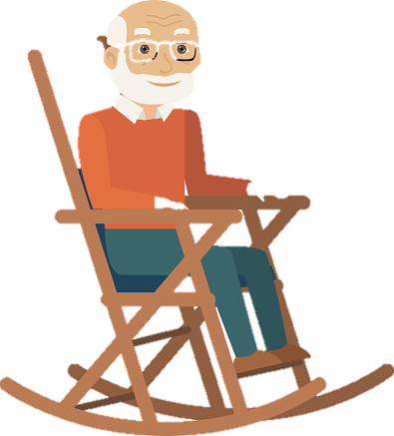
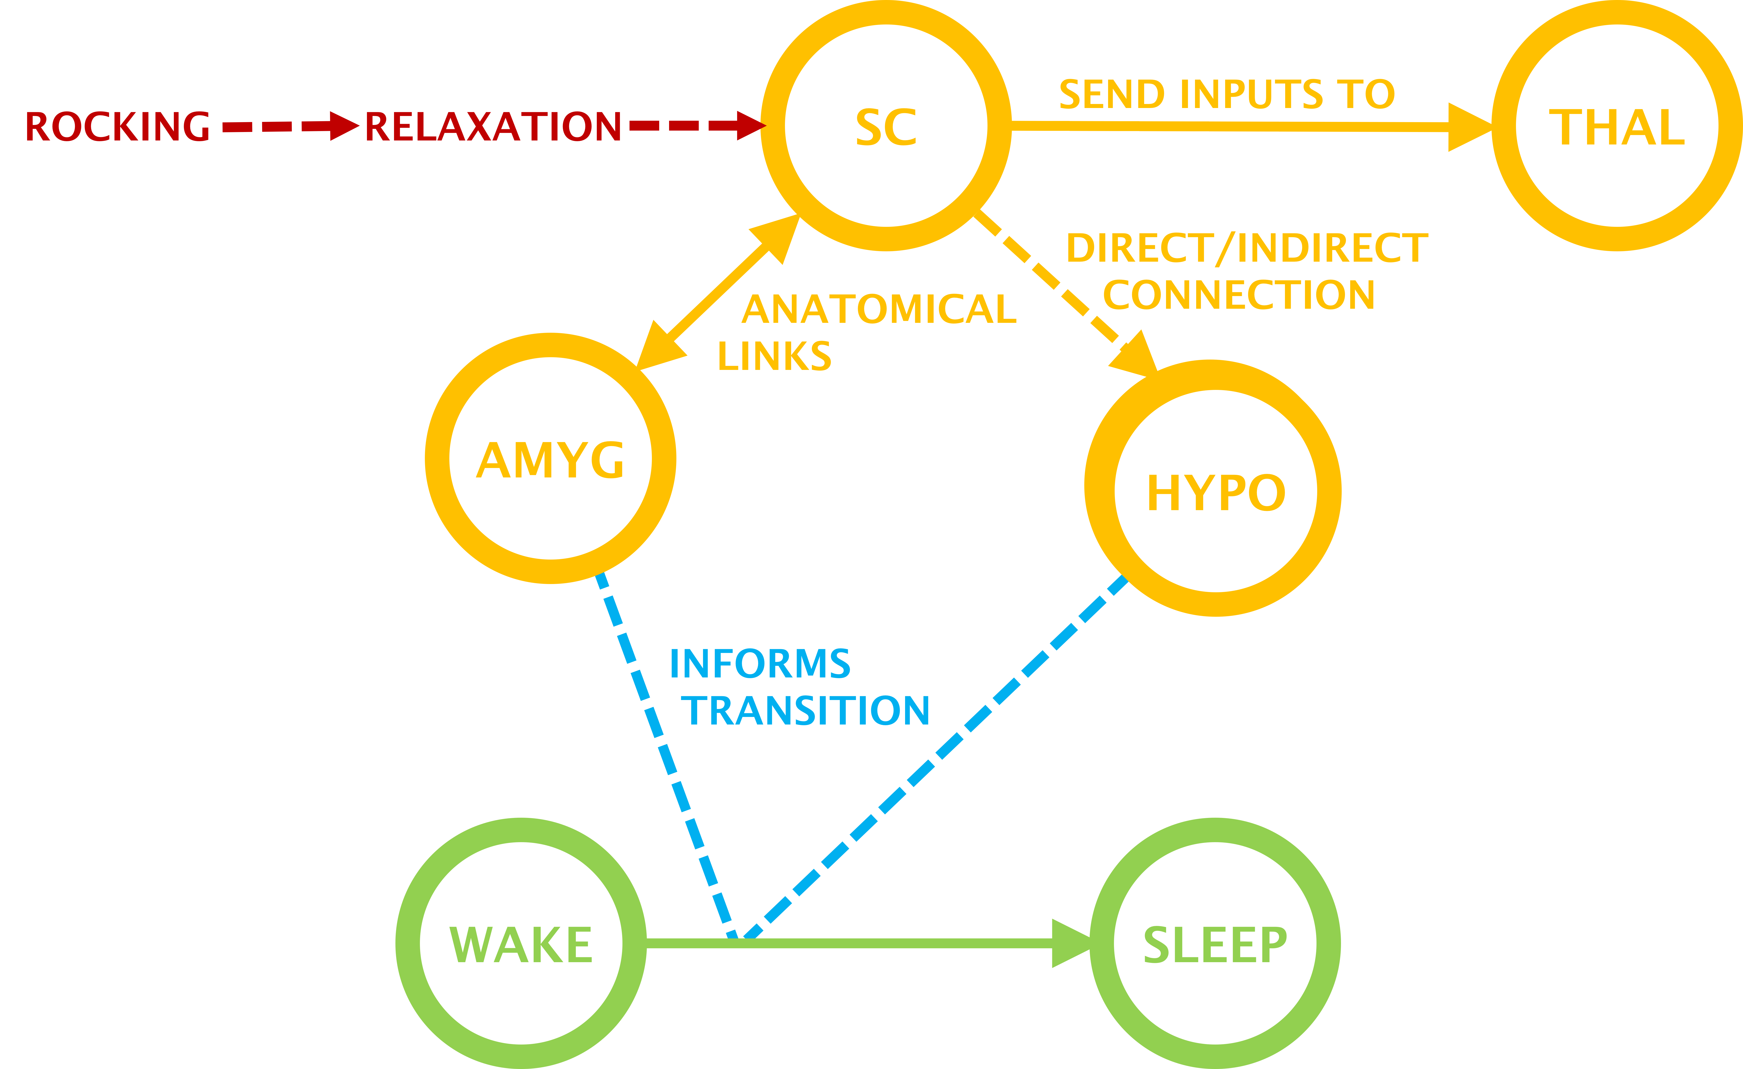
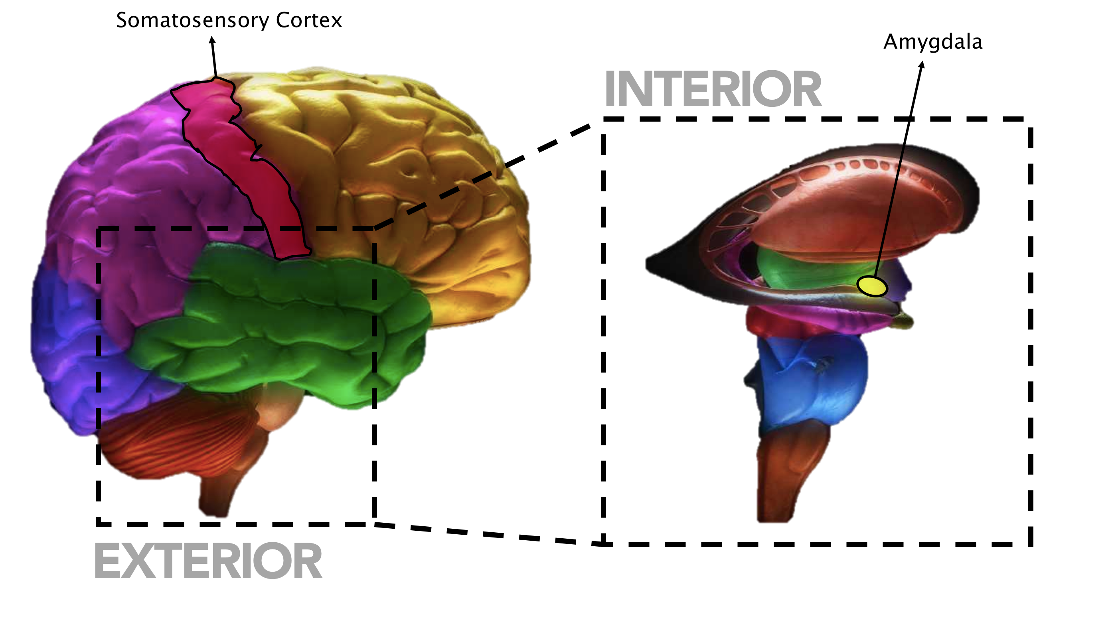
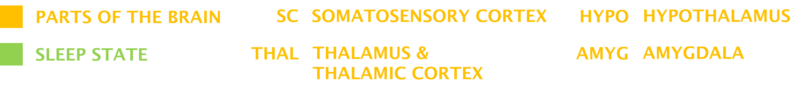
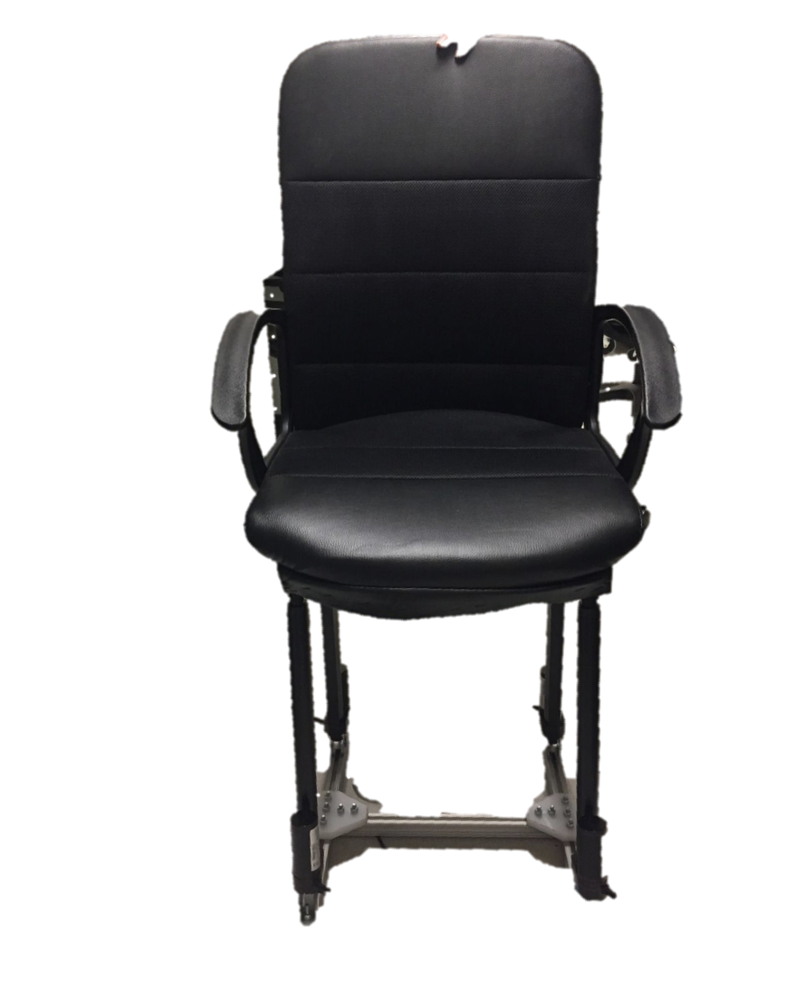
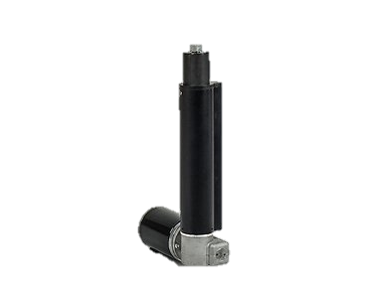
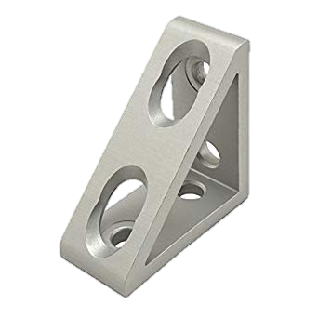
ROCKING IS THE NEW RUNNING
REFACTORING THE AGE-OLD TECHNIQUE INTO A WORKPLACE INTERVENTION
WITH ROBOTIC CHAIR THAT AUTOMATICALLY INTERVENES FOR USERS’ COMFORT
MOTIVATION
50-70%
The portion of the day that an average adult spends sitting. This can lead to diabetes, cardiovascular diseases, and even premature death.
Unfortunately, exercising during the rest of the day cannot make up for this. Since reducing this sitting time is not practical, we attempt to make the time we spend sitting less harmful.
APPROACH
We use rocking as a stimulus. Recent work has shown that the the swinging motion reinforces endogenous sleep rhythms and leads to faster onset of sleep. Active rocking has positive psychosocial impact on dementia patients and infants, with calming effects on anxiety.
BACKGROUND
Rocking induces sensory stimulations in the somatosensory cortex, which informs a wake-sleep state transition in one of three possible ways, suggesting that rocking is relaxing.
DESIGN
IKEA Chair
Design utilizes elevation of four corners to simulate rocking. Future iterations will utilize seat curvature-controlling model.
Base frame supports vertical force, as well as lateral force on actuators when user sits in chair and actuators slant.
+
CHAIR
Linear
Actuators
+
Base Frame made with 80/20 Rods
EXPERIMENT
VARIABLES
STUDY
PRELIMINARY RESULTS
• Stress Level
• Focus
• Task Performance
=
or
Stimulus
Task
Static 1/6 Hz sideways rocking
Combination of the Sing-a-Song stress test, Mental Math problems, Whack-a-Mole test, and the Trier Social Stress Test
During pilot studies, all participants (N=3 of 3) found the rocking pleasant.
=
or
MANAN RAI, AMANDA SPYROPOULOS, MICHAEL UTTMARK, Prof. DORSA SADIGH, Dr. PABLO PAREDES
School of Medicine, Stanford • Pervasive Wellbeing Technology Lab, Precision Health and Integrated Diagnostics (PHIND) • Department of Computer Science, Stanford | med.stanford.edu/pervasivewellbeingtech.html

